Slide 1
myJournal
mental health tracker
Team 5
Matt Elpus, Daniel Guthart, Jade Tustin

Slide 2

System Overview
myJournal makes tracking mental health easy.
Users can log in, register, view their dashboard, and manage their journal entries effortlessly.
Users can access their journals from anywhere that has a secure internet connection, including via web browser or by using their preferred mobile device.
The result? A seamless experience for users that enables them to track their mental well-being on their own terms.

Slide 3
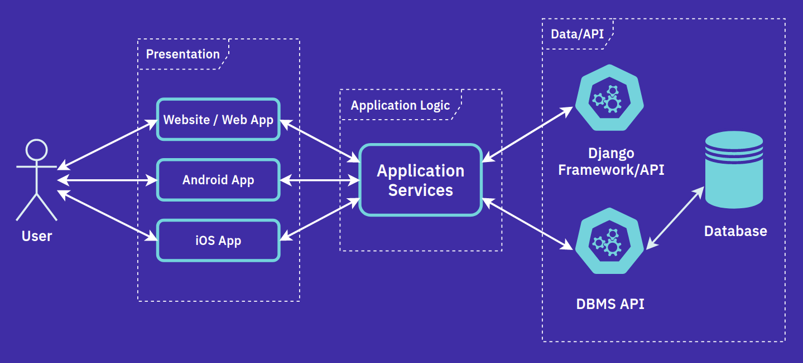
System Diagram

Slide 4


Description of Actors
There are two main human actors who may interact with the myJournal system: non-registered users and registered users.
Non-registered users may only interact with the system in order to register and cannot access any of myJournal’s journaling and dashboard features.
Once a user is registered, they will be able to access the entire myJournal system, including the capability to create and edit journal entries.

Slide 5


Architectural Style
This system will use a three-tier architecture.
This allows the system to utilize elements of both database-centric and client-server architectures while employing an additional layer to fulfill user requests and handle security & privacy protocols.
By employing an architecture with this structure, the myJournal team can easily create and maintain a consistent user experience while leaving the system open to enhancements in the future.

Slide 6
Architectural Style
The three ‘tiers’ of the myJournal system are as follows:
Presentation tier that unifies the user experience across multiple platforms
Application logic tier to streamline all end-user services into a unified, easy-to-maintain layer
Data/API tier to handle relevant API calls for both the Django framework and the database management system

Slide 7
Design Patterns
Some common software design patterns will be used in the myJournal system.
The factory design pattern will be used to simplify the creation of new objects. In the context of the myJournal system, this will be used for the creation of new user accounts and journal entries.
The singleton pattern restricts an application to the creation of only one instance of a class. This will be used for the database connection pool, which should only have a single class instance at any time.
As development progresses, it may be necessary to utilize other design patterns in order to facilitate ease of development and maintenance.

Slide 8
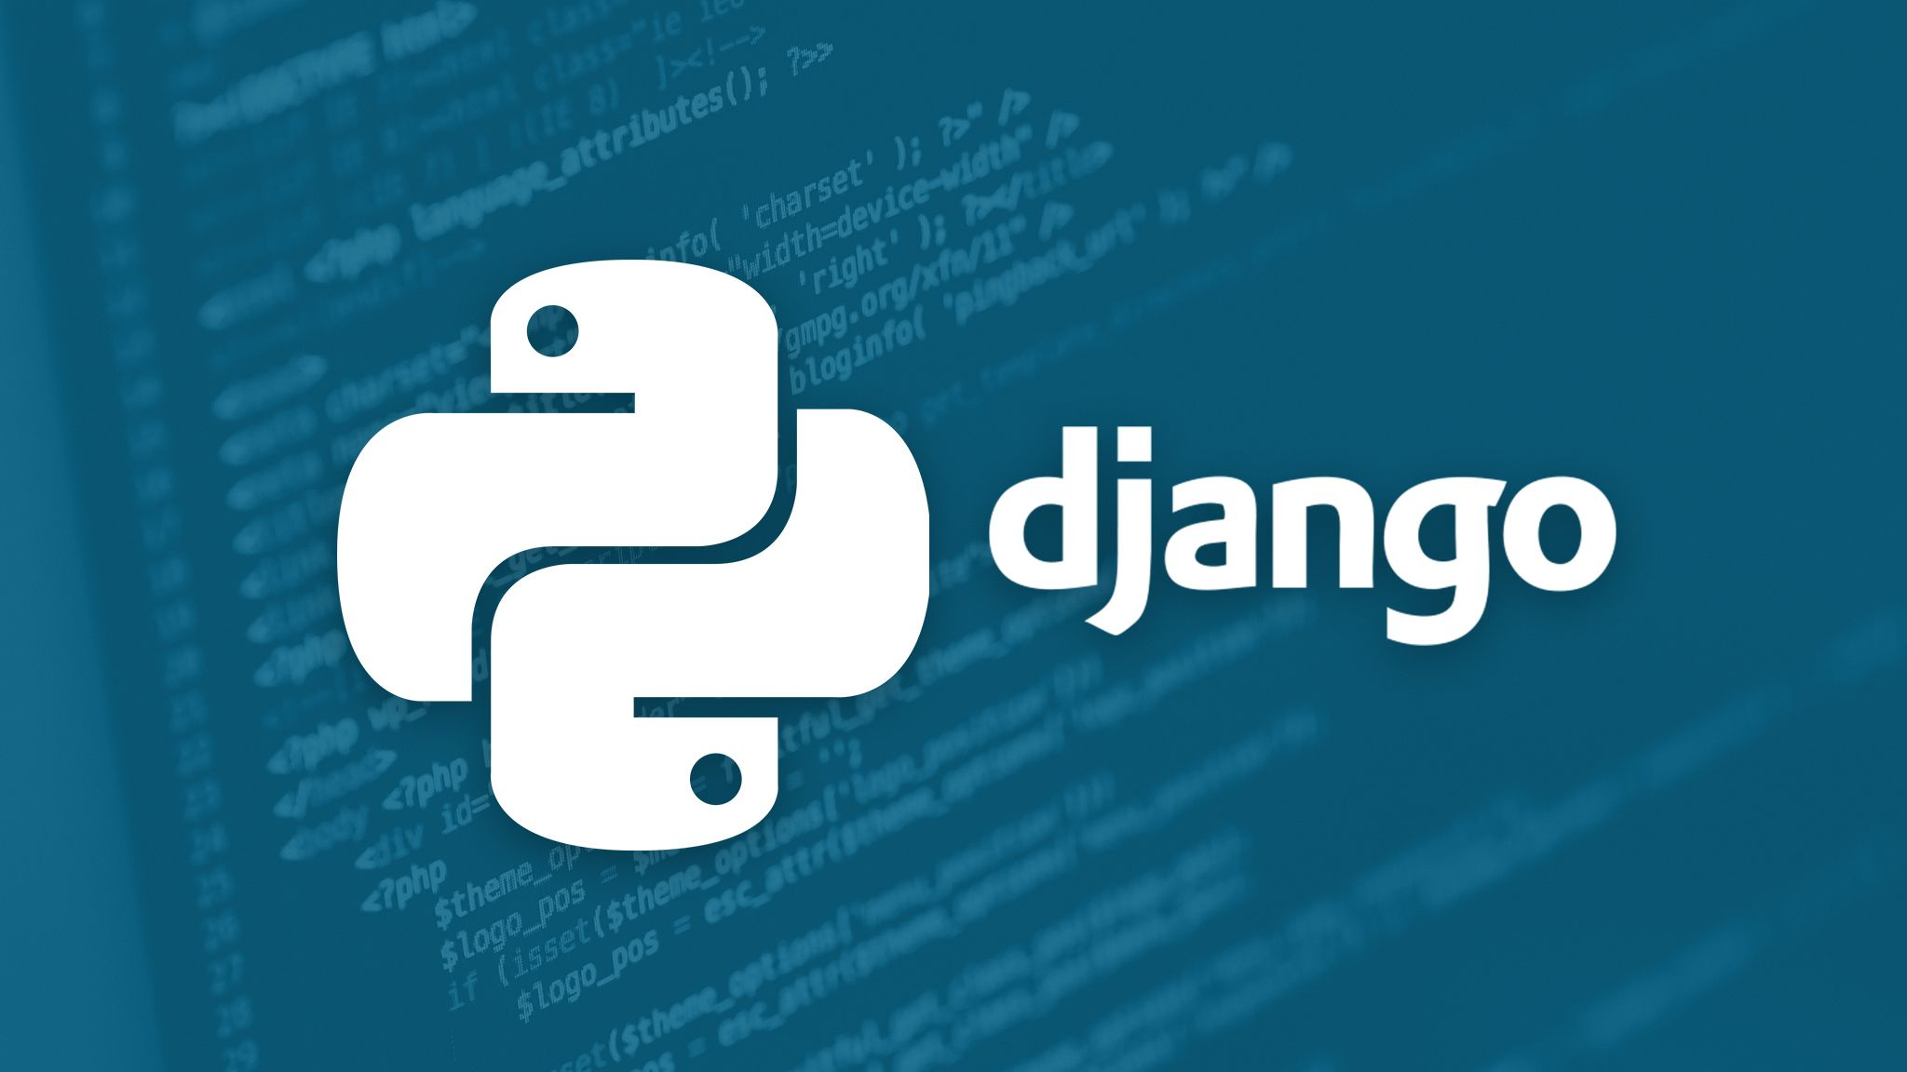

Frameworks
As has been discussed throughout, myJournal will deploy the Django framework.
This framework is based on the Python programming language and serves as a helpful tool in both developing and maintaining a quality cross-platform user experience.
You probably use Django apps every day without even realizing it! Some popular apps that deploy the Django framework include Instagram, Spotify, and YouTube.

Slide 9
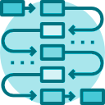
Let’s take a look at some diagrams showing how users may interact with the system.
Sequence Diagrams

Slide 10
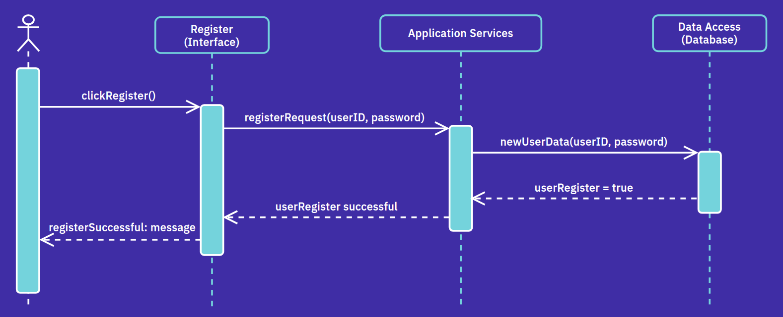
Sequence Diagrams
Register

Slide 11
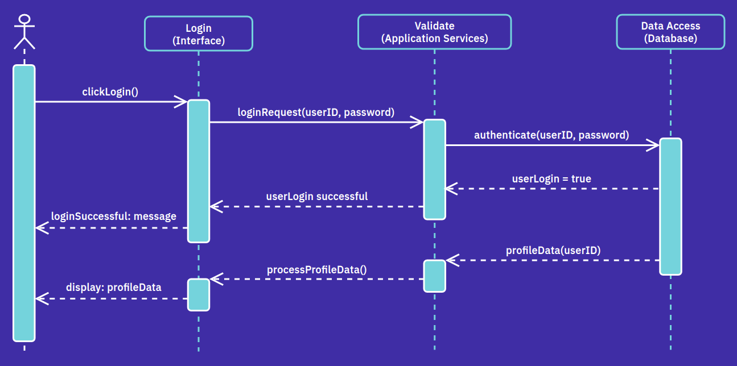
Sequence Diagrams
Login

Slide 12
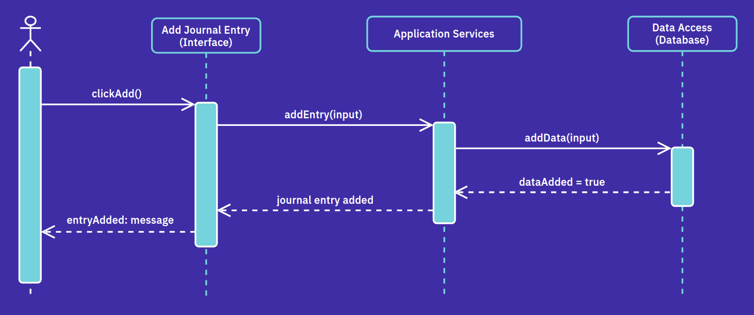
Sequence Diagrams
Add Journal Entry

Slide 13
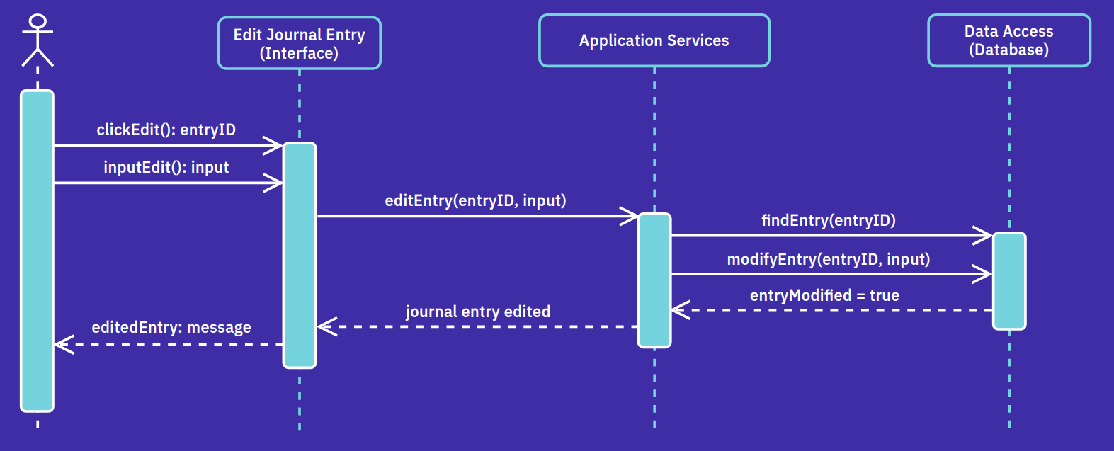
Sequence Diagrams
Edit Journal Entry

Slide 14
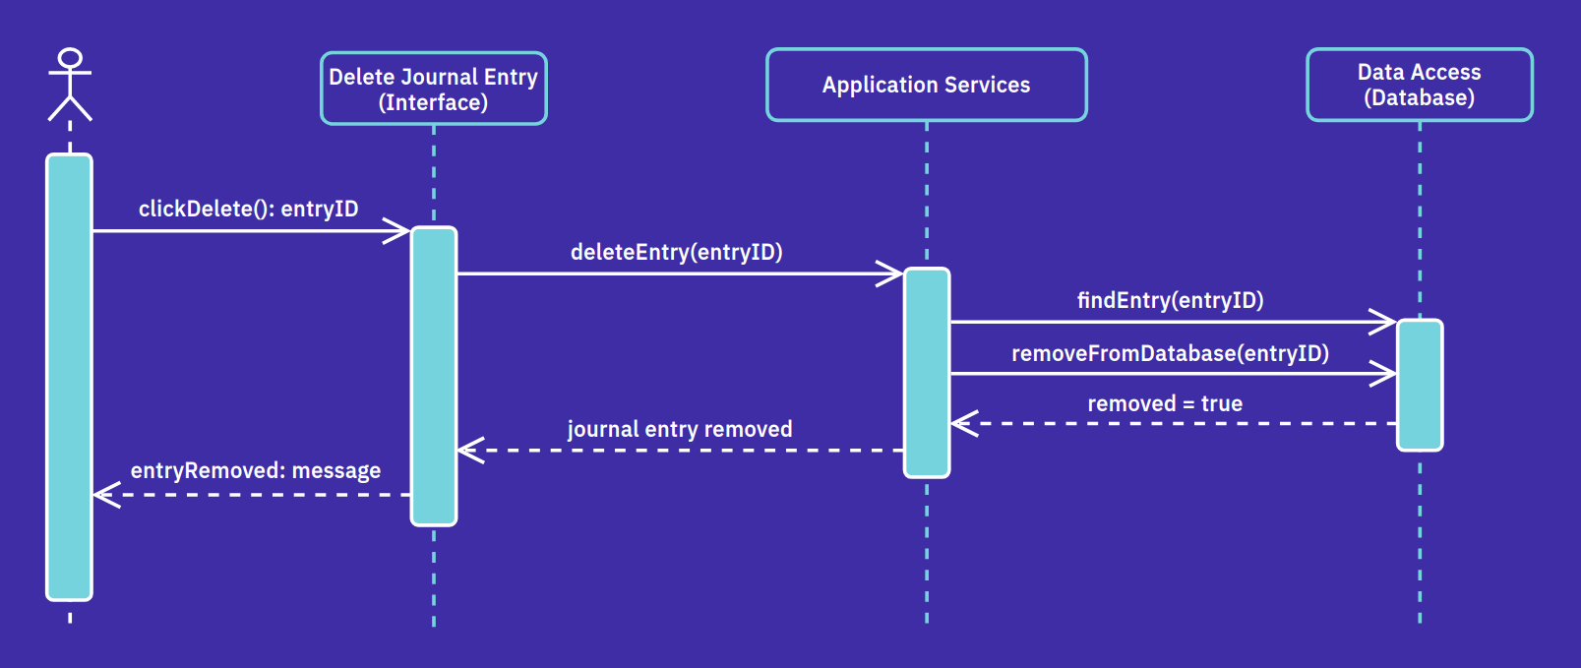
Sequence Diagrams
Delete Journal Entry

Slide 15
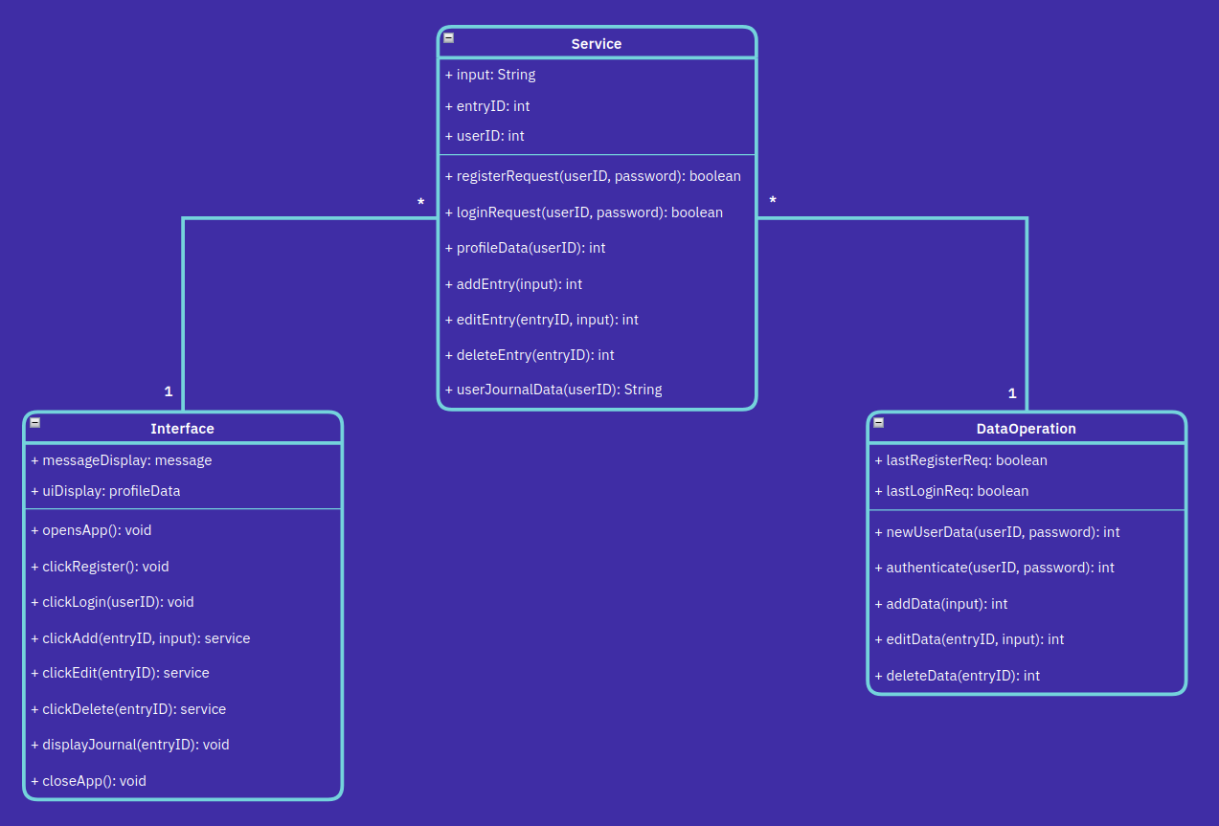
Class Diagram

Slide 16
So, what will myJournal look like?

Slide 17
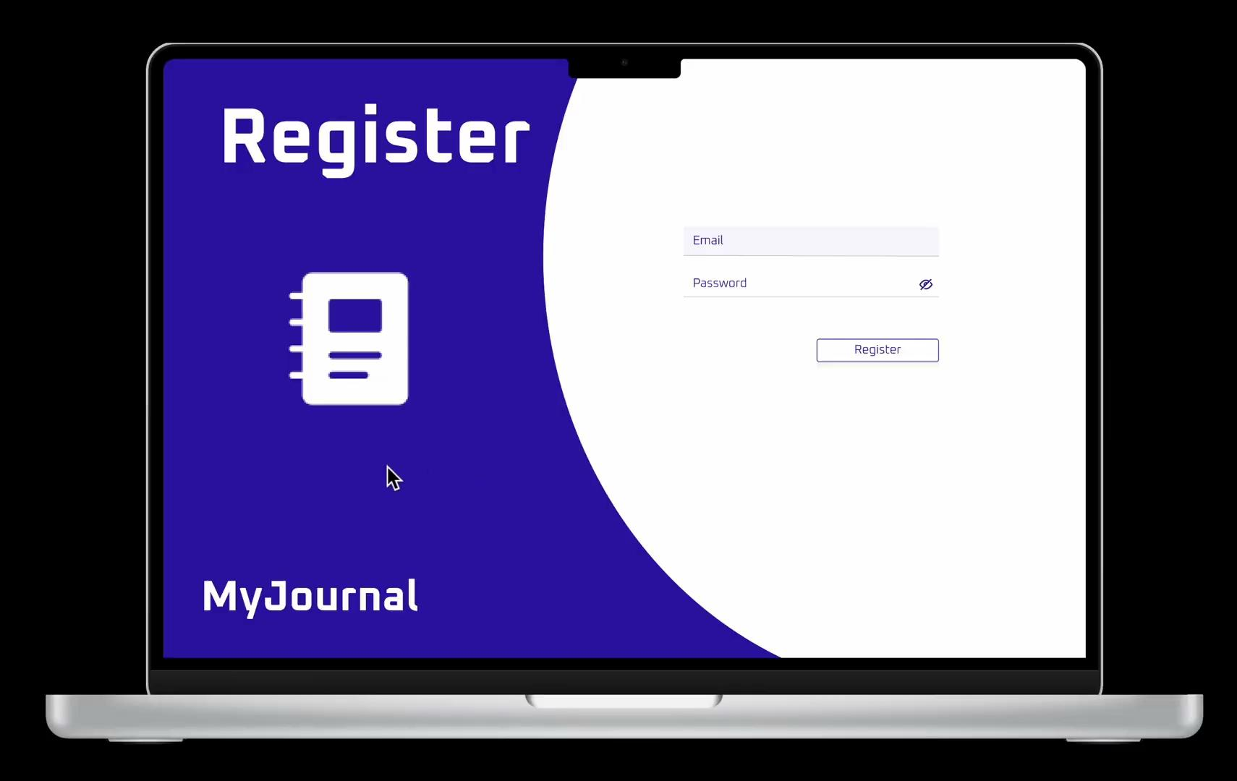

Slide 18
Thank you for your time!
Any questions?

